Slide 1
Software Subsystem of Learning Management System

Slide 2
Team Organization
Democratic Egoless Program Team
-We are equally sharing responsibility
Members:
Amairani Aguilera
Jesus Daniel Reveles
Travis Piwetz
Laura Palacios
James Rayford

Slide 3
Techniques for project
Coding Language: HTML 5, PHP, SQL
IDE: Visual Studio Code
Data storage and retrieval: SQL
GUI generation: HTML 5

Slide 4
Github Repo DEMO
https://github.com/Shabadoo89/Moodle_LSM-2.0

Slide 5
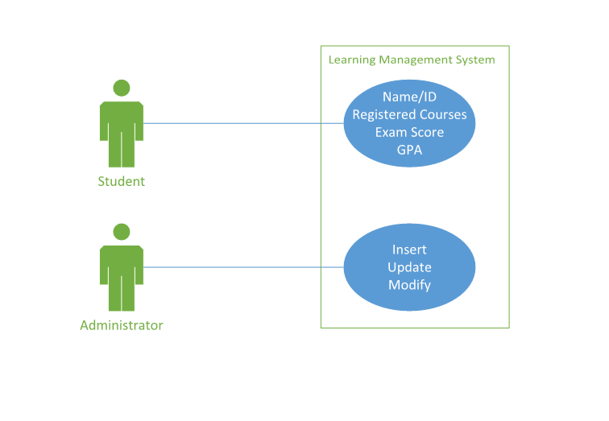
Requirements and analysis workflow: use case diagram

Slide 6
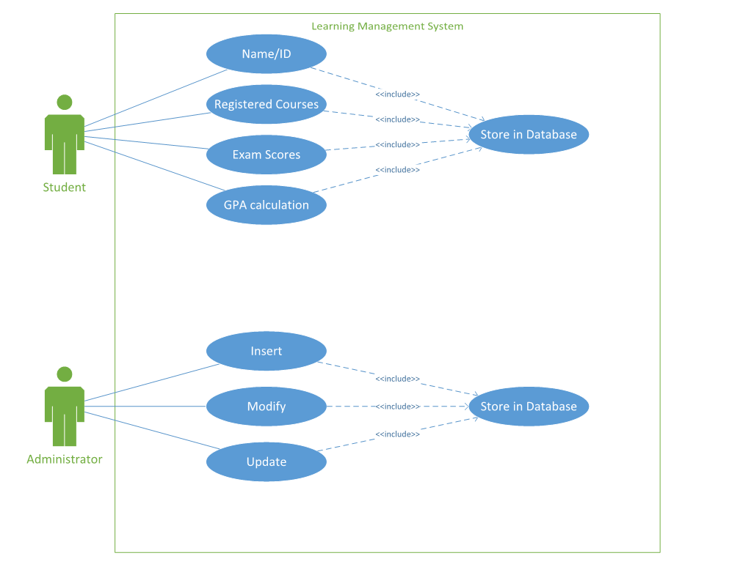
Requirements and analysis workflow: use case diagram

Slide 7
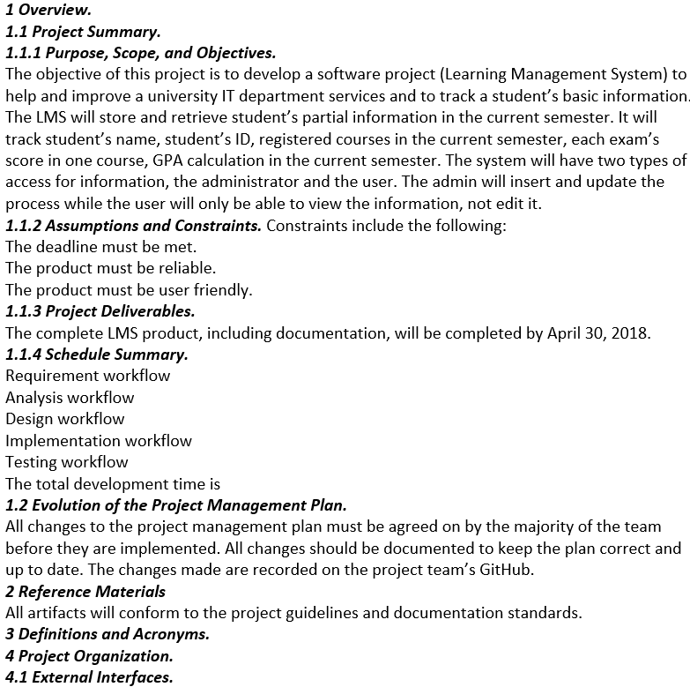
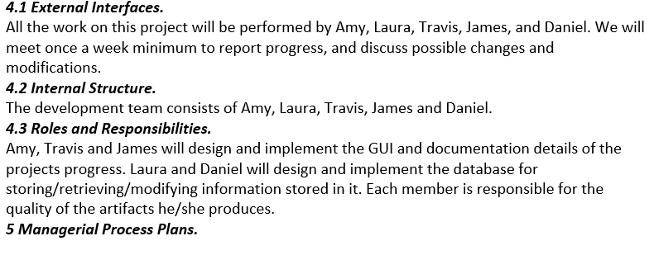
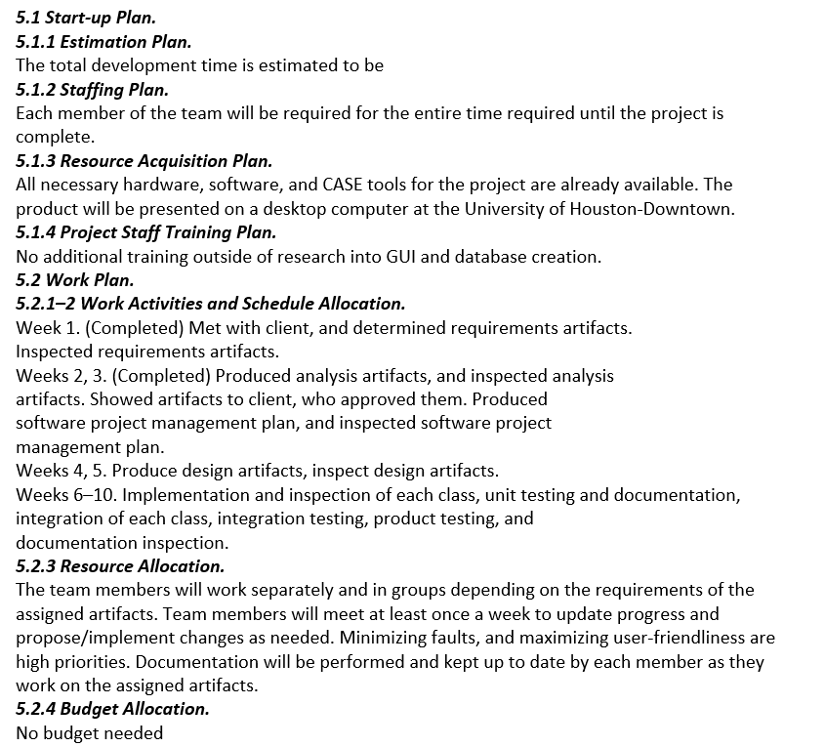
Requirements and analysis workflow: software project management plan

Slide 8
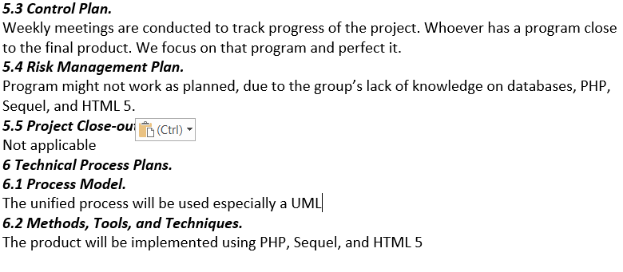
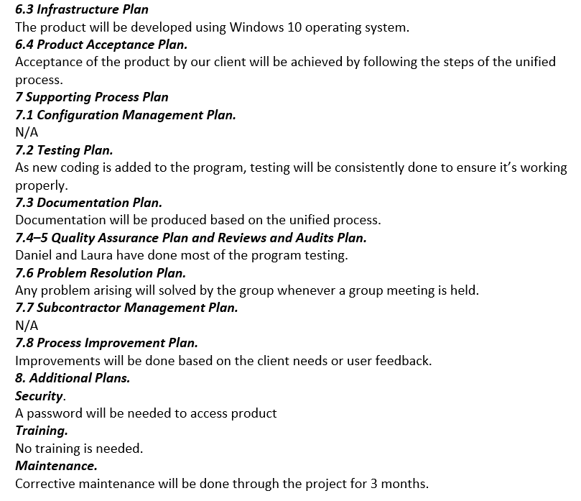
Requirements and analysis workflow: software project management plan

Slide 9
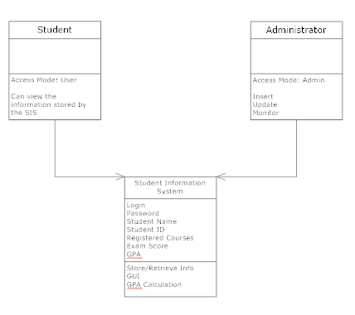
Requirements and analysis workflow: UML

Slide 10
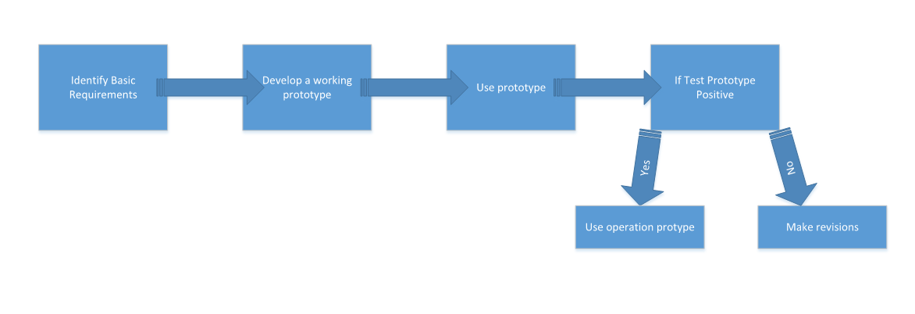
Requirements and analysis workflow: prototype for basic Requirements

Slide 11
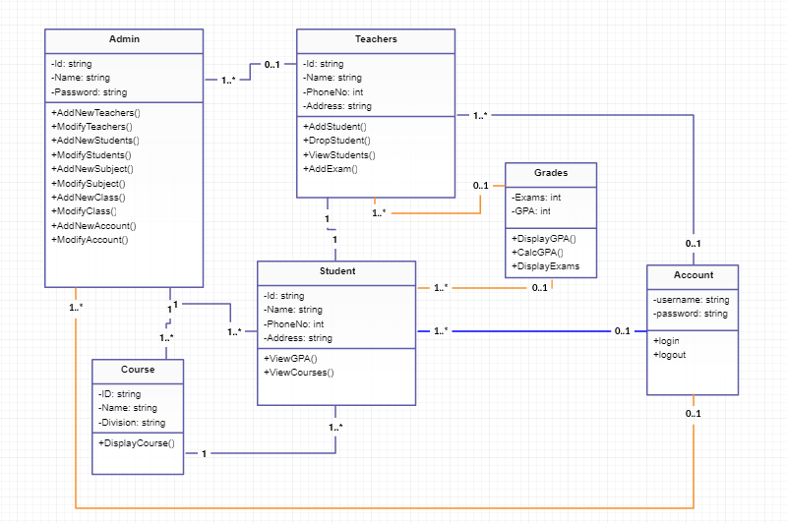
Design and implementation workflow: Class diagram

Slide 12
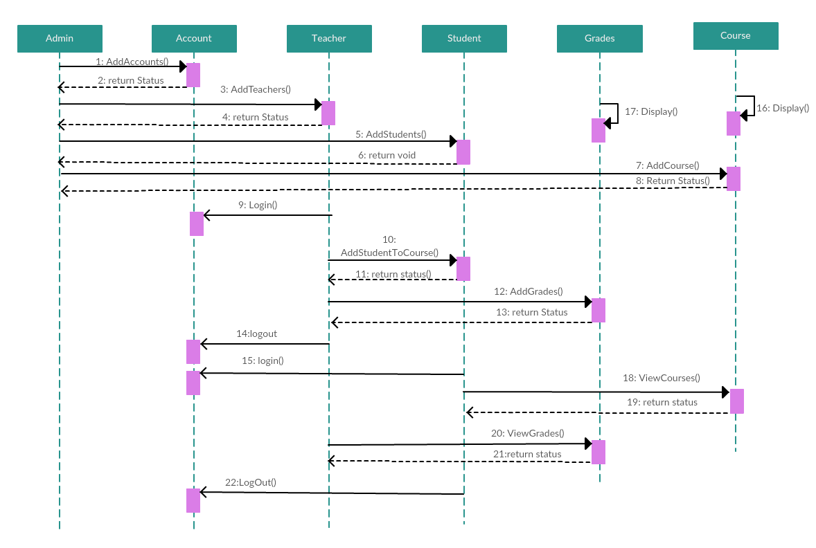
Design and implementation workflow: sequence and interaction diagram

Slide 13
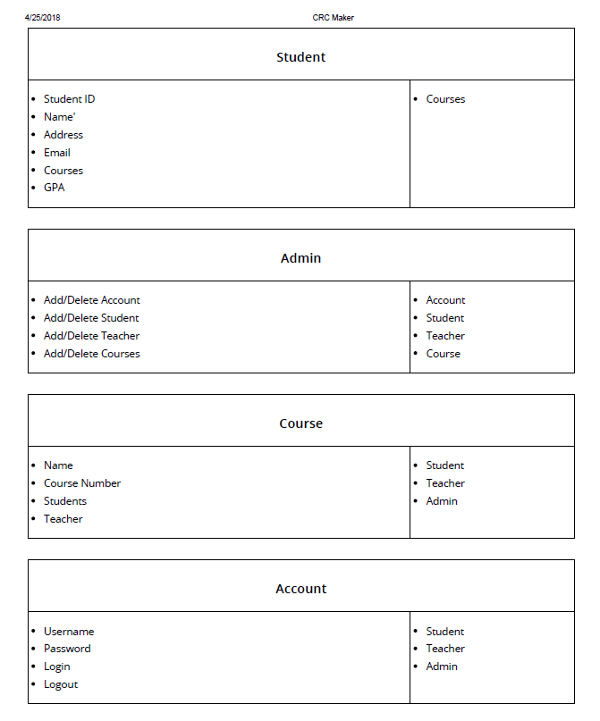
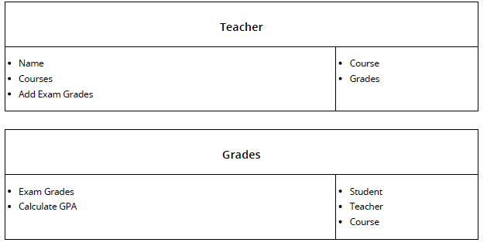
Design and implementation workflow: Crc card

Slide 14
Design and implementation workflow: use case / integration testing
Case | Test Case | Input | Expected Output | Actual Output | Pass/Fail
1 | Test case for login | Username and password | Log in successful | Log in Successful | Pass
2 | Test case for GPA calculation | Select option to show GPA calculation | Shows calculated GPA | Shows calculated GPA | Pass
3 | Test case for modifying student info | Select option to edit student info | Allows administrator to edit anything | Blank page | Fail
4 | Test case for adding student info | Select option to add student info | Allows administrator add student info | Blank page | Fail
5 | Test case for administrator viewing all students | Admin view all info | Student only sees itself | Administrator views all students | Pass

Slide 15
Program Demo

